Slide 1
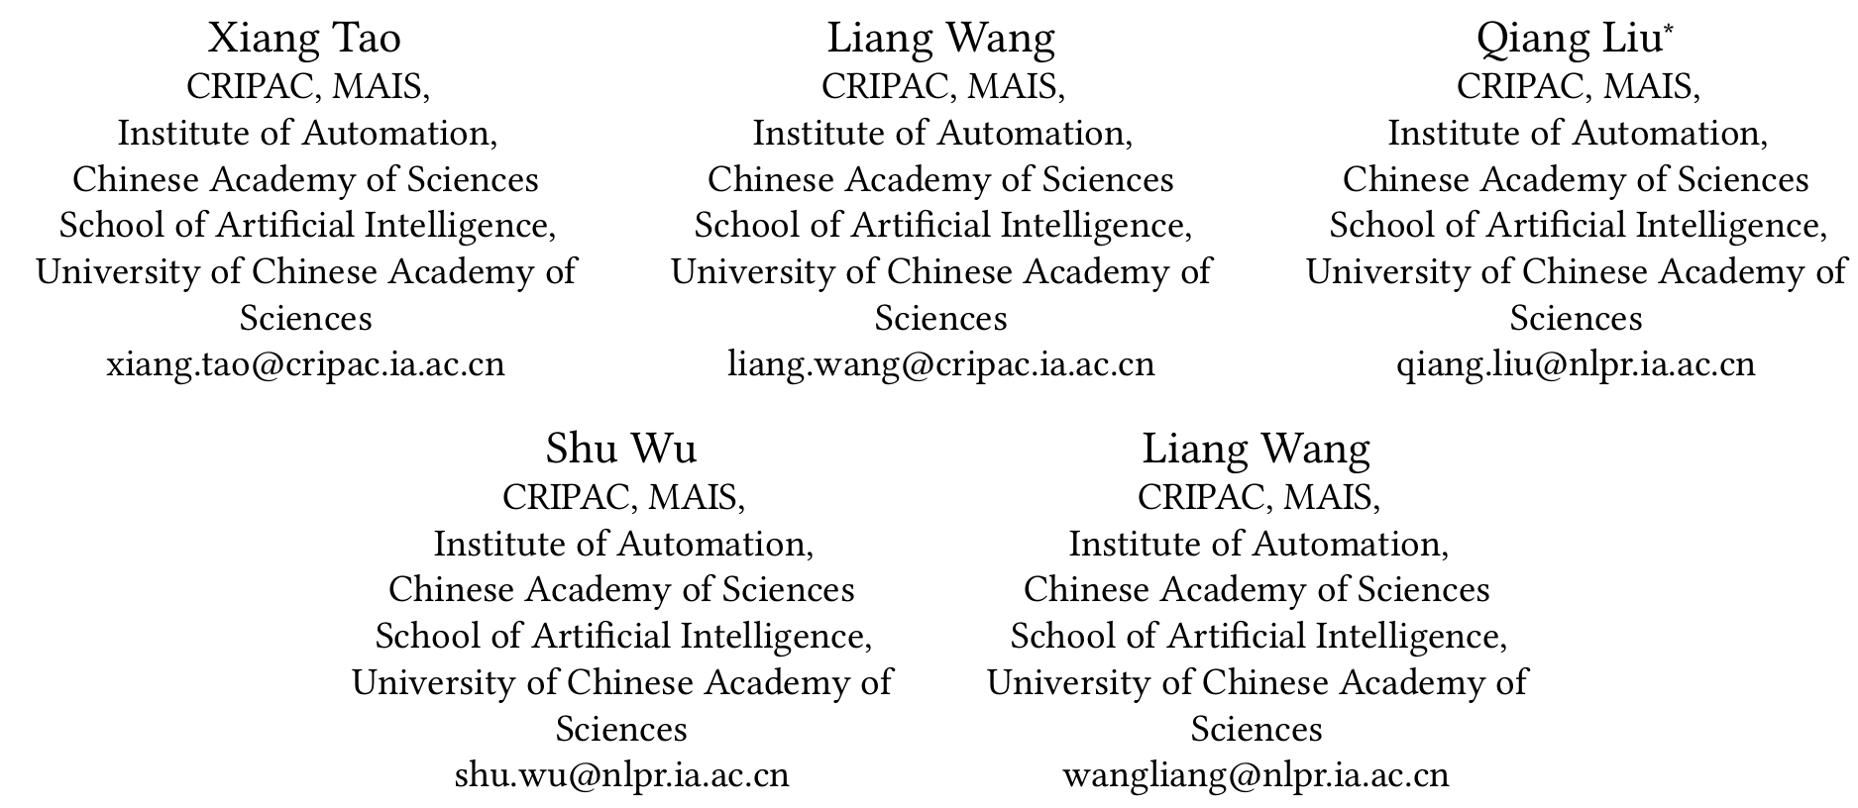
ATAI
Advanced Technique of Artificial Intelligence
ATAI
ChongqingUniversity _{AdvancedTechniqueof}
of Technology Artificial Intelligence
Chongqing University of
Technology
Chongqing University ^{ATAI}
_{of Technology} Advanced Techniqueof
Artificial Intelligence
Chongqing University of Technology
Chongqing University of Technology
Semantic Evolvement Enhanced Graph Autoencoder
for Rumor Detection
Code : None
—— WWW’2024
Reported by Yang Jiang
1

Slide 2
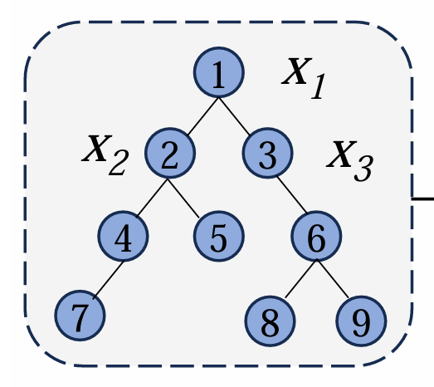
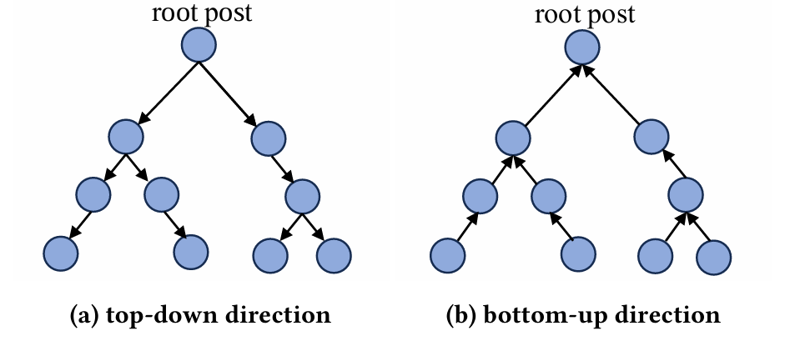
ATAI
Advanced Technique of Artificial Intelligence
ATAI
ChongqingUniversity _{AdvancedTechniqueof}
of Technology Artificial Intelligence
Chongqing University of
Technology
Chongqing University ^{ATAI}
_{of Technology} Advanced Techniqueof
Artificial Intelligence
Chongqing University of Technology
Chongqing University of Technology
Introduction
These models lack attention to the semantic evolvement during news propagation. Comments of news often present diverse viewpoints due to different perspectives and positions, which contribute to the alteration of the semantic meaning of the news.

Slide 3
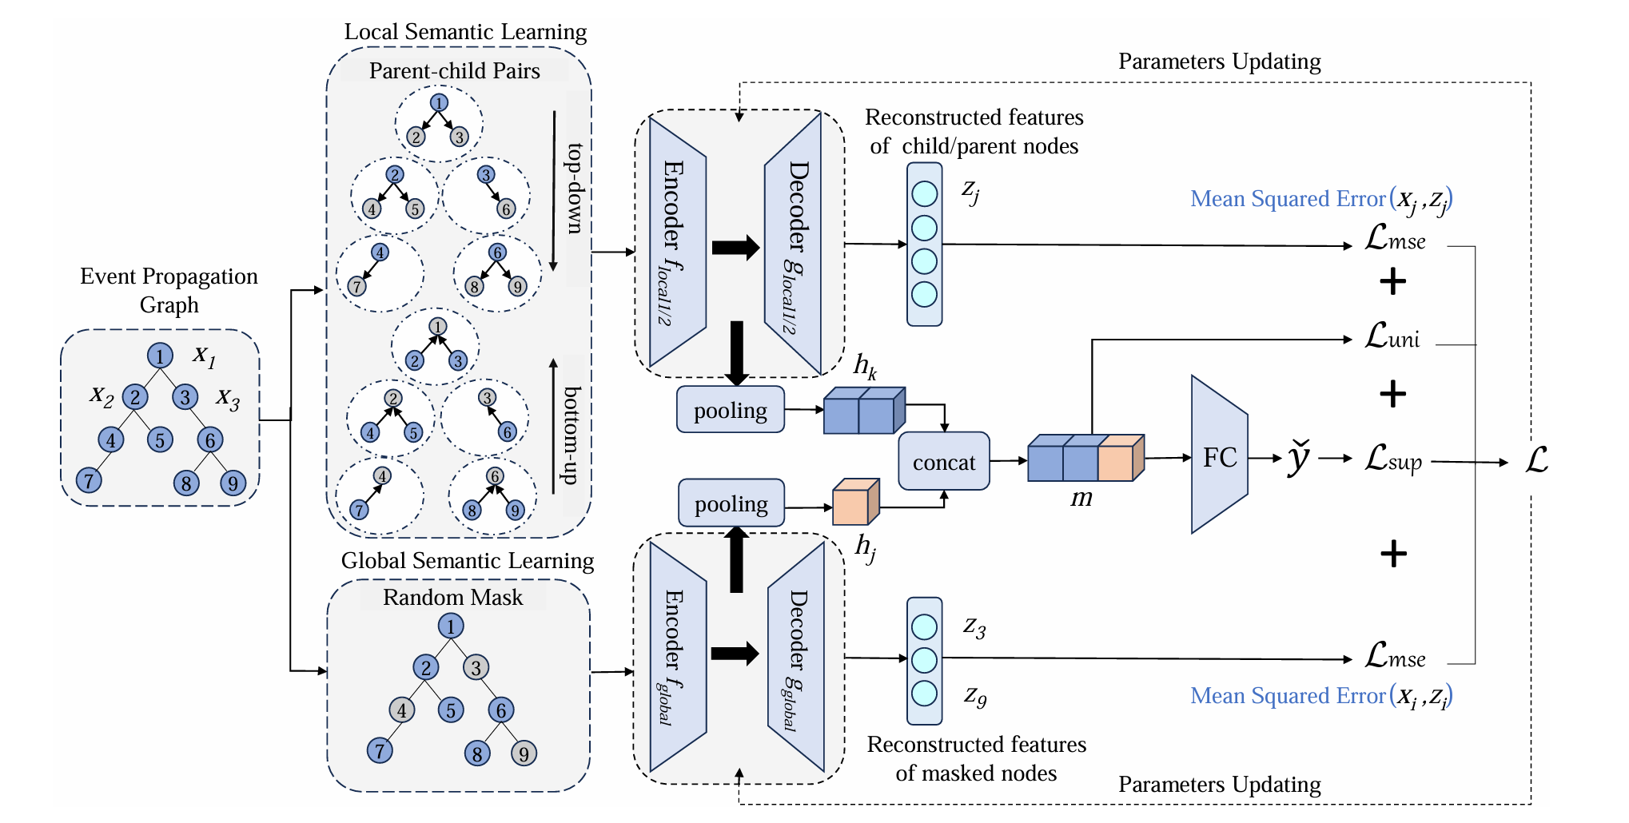
ATAI
Advanced Technique of Artificial Intelligence
ATAI
ChongqingUniversity _{AdvancedTechniqueof}
of Technology Artificial Intelligence
Chongqing University of
Technology
Chongqing University ^{ATAI}
_{of Technology} Advanced Techniqueof
Artificial Intelligence
Chongqing University of Technology
Chongqing University of Technology
Overview

Slide 4
ATAI
Advanced Technique of Artificial Intelligence
ATAI
ChongqingUniversity _{AdvancedTechniqueof}
of Technology Artificial Intelligence
Chongqing University of
Technology
Chongqing University ^{ATAI}
_{of Technology} Advanced Techniqueof
Artificial Intelligence
Chongqing University of Technology
Chongqing University of Technology
Definition

Slide 5
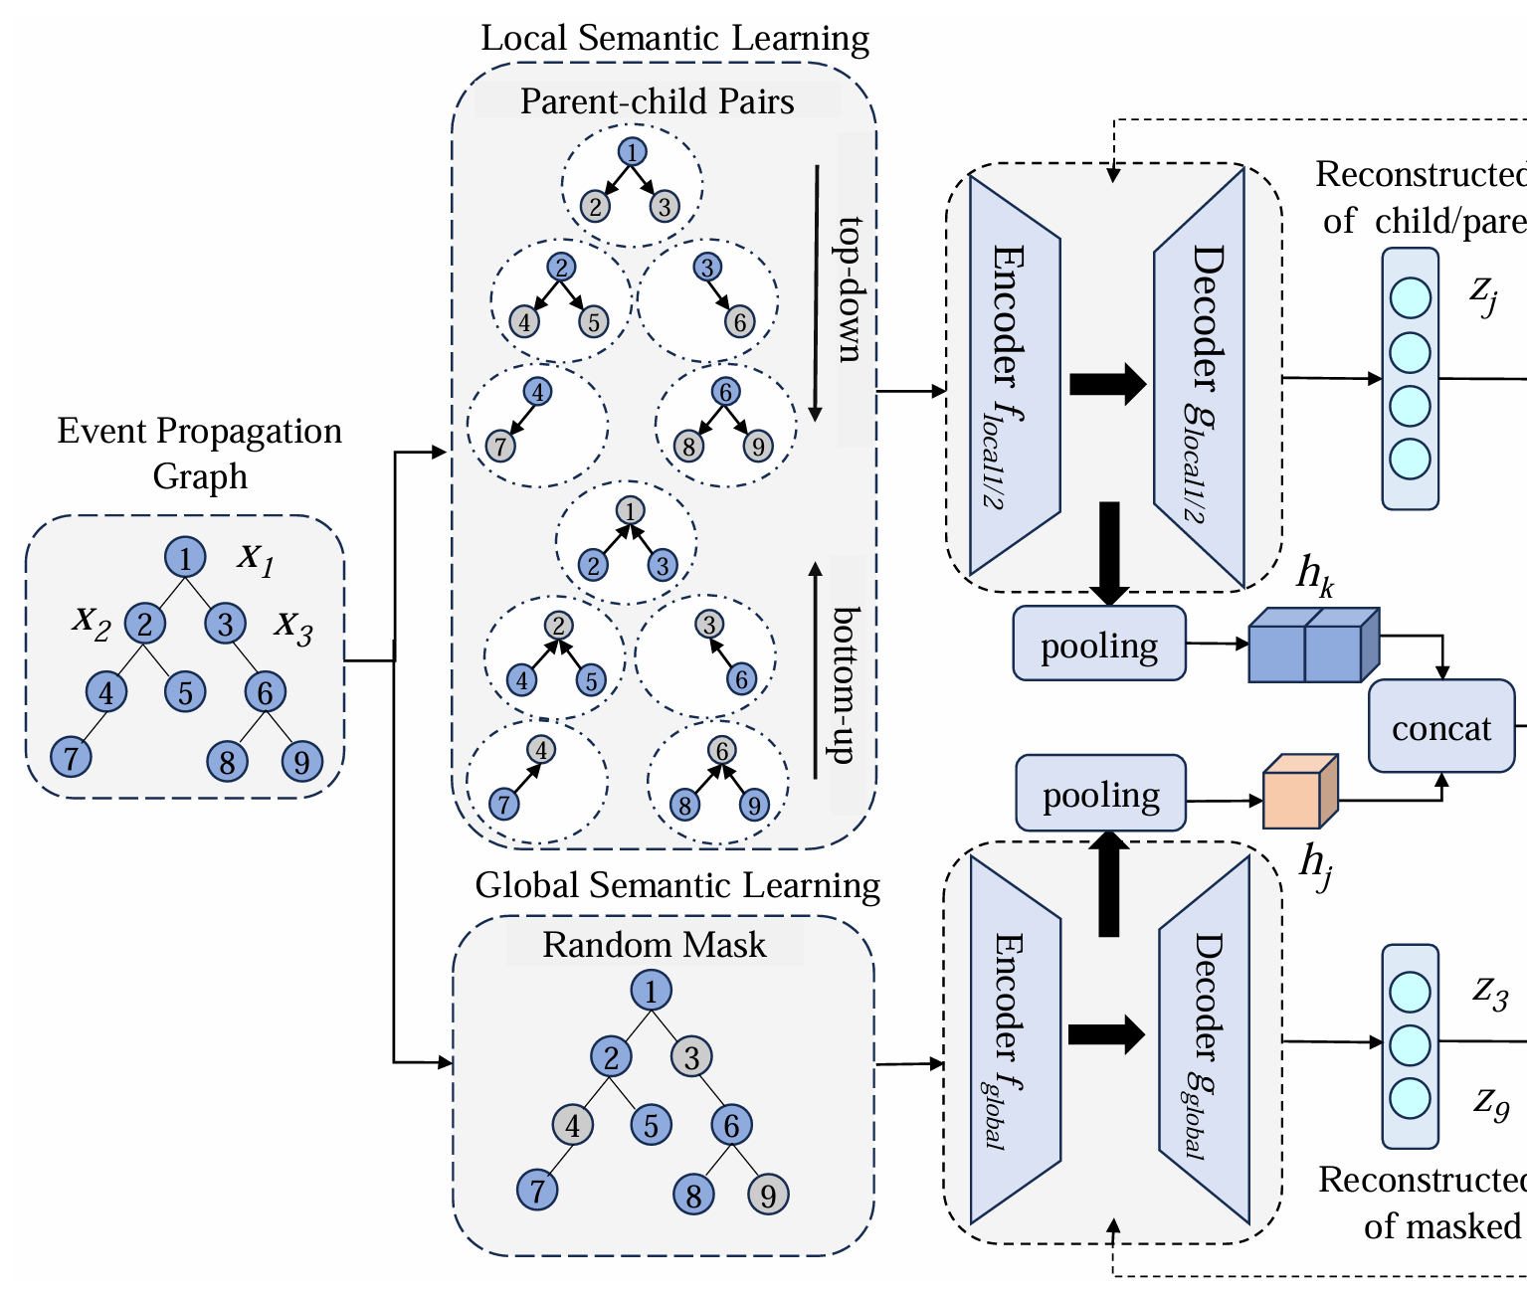
ATAI
Advanced Technique of Artificial Intelligence
ATAI
ChongqingUniversity _{AdvancedTechniqueof}
of Technology Artificial Intelligence
Chongqing University of
Technology
Chongqing University ^{ATAI}
_{of Technology} Advanced Techniqueof
Artificial Intelligence
Chongqing University of Technology
Chongqing University of Technology
Method
Local Semantic Evolvement Learning

Slide 6
ATAI
Advanced Technique of Artificial Intelligence
ATAI
ChongqingUniversity _{AdvancedTechniqueof}
of Technology Artificial Intelligence
Chongqing University of
Technology
Chongqing University ^{ATAI}
_{of Technology} Advanced Techniqueof
Artificial Intelligence
Chongqing University of Technology
Chongqing University of Technology
Method
Global Semantic Evolvement Learning

Slide 7
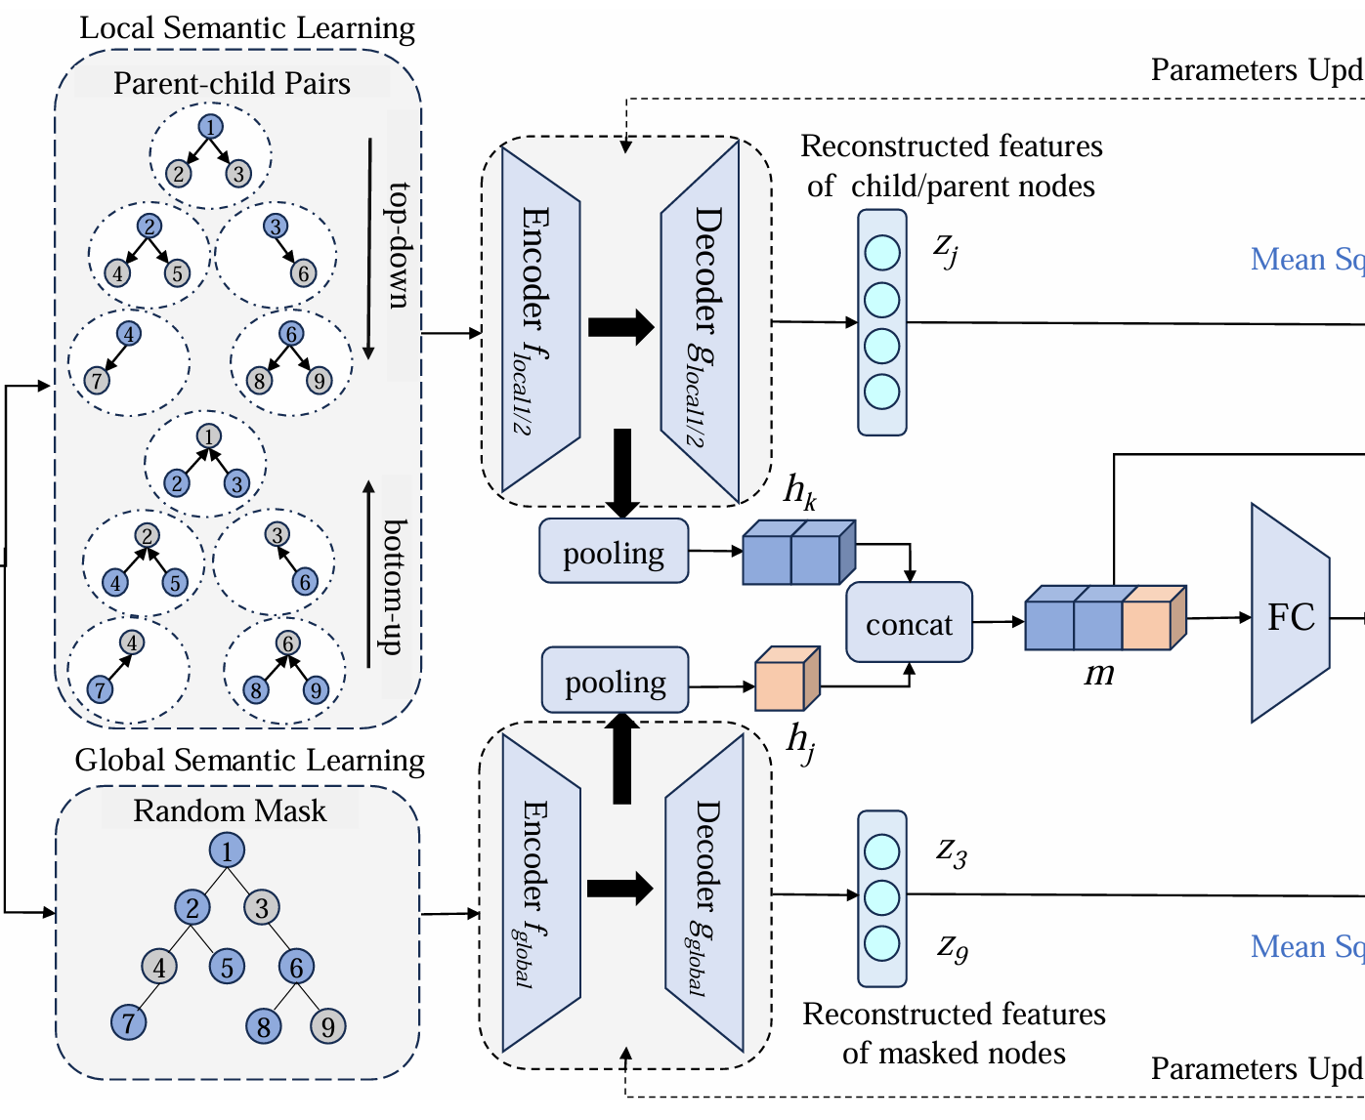
ATAI
Advanced Technique of Artificial Intelligence
ATAI
ChongqingUniversity _{AdvancedTechniqueof}
of Technology Artificial Intelligence
Chongqing University of
Technology
Chongqing University ^{ATAI}
_{of Technology} Advanced Techniqueof
Artificial Intelligence
Chongqing University of Technology
Chongqing University of Technology
Method
Representation of Propagation Graph

Slide 8
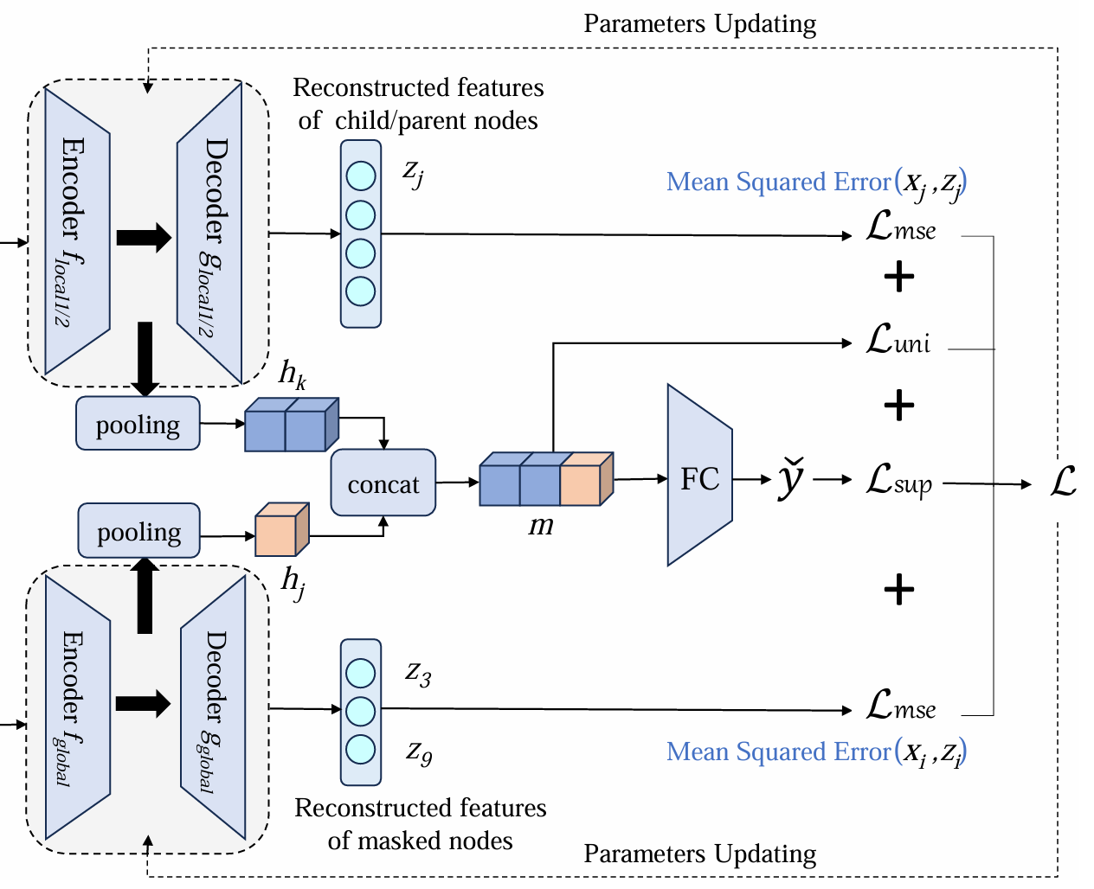
ATAI
Advanced Technique of Artificial Intelligence
ATAI
ChongqingUniversity _{AdvancedTechniqueof}
of Technology Artificial Intelligence
Chongqing University of
Technology
Chongqing University ^{ATAI}
_{of Technology} Advanced Techniqueof
Artificial Intelligence
Chongqing University of Technology
Chongqing University of Technology
Method
Uniformity Regularizer

Slide 9
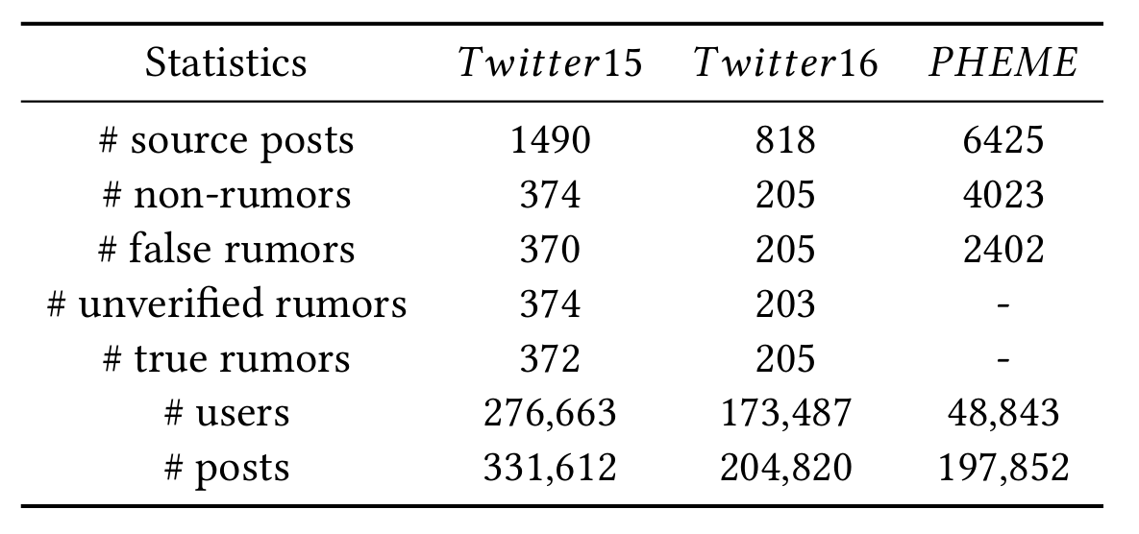
ATAI
Advanced Technique of Artificial Intelligence
ATAI
ChongqingUniversity _{AdvancedTechniqueof}
of Technology Artificial Intelligence
Chongqing University of
Technology
Chongqing University ^{ATAI}
_{of Technology} Advanced Techniqueof
Artificial Intelligence
Chongqing University of Technology
Chongqing University of Technology
Experiments

Slide 10
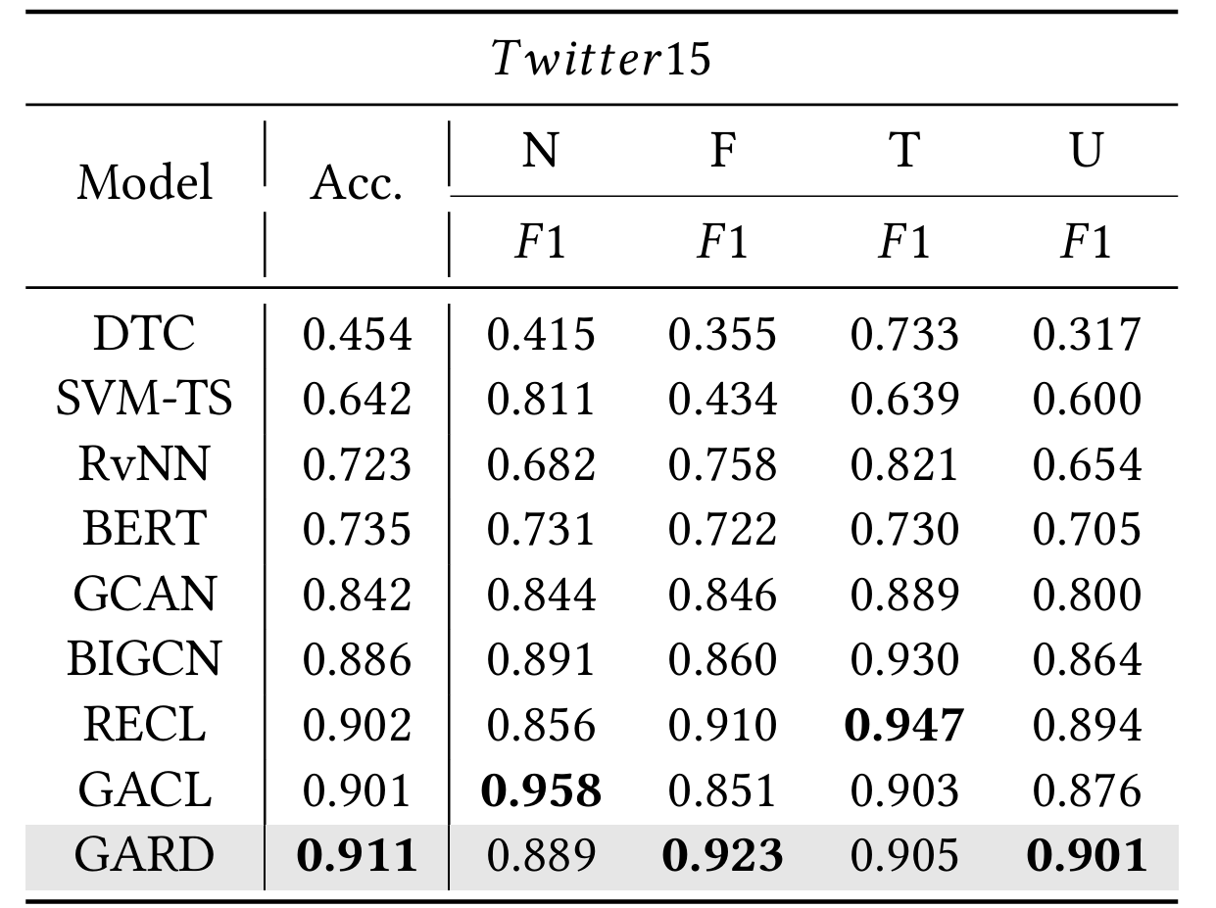
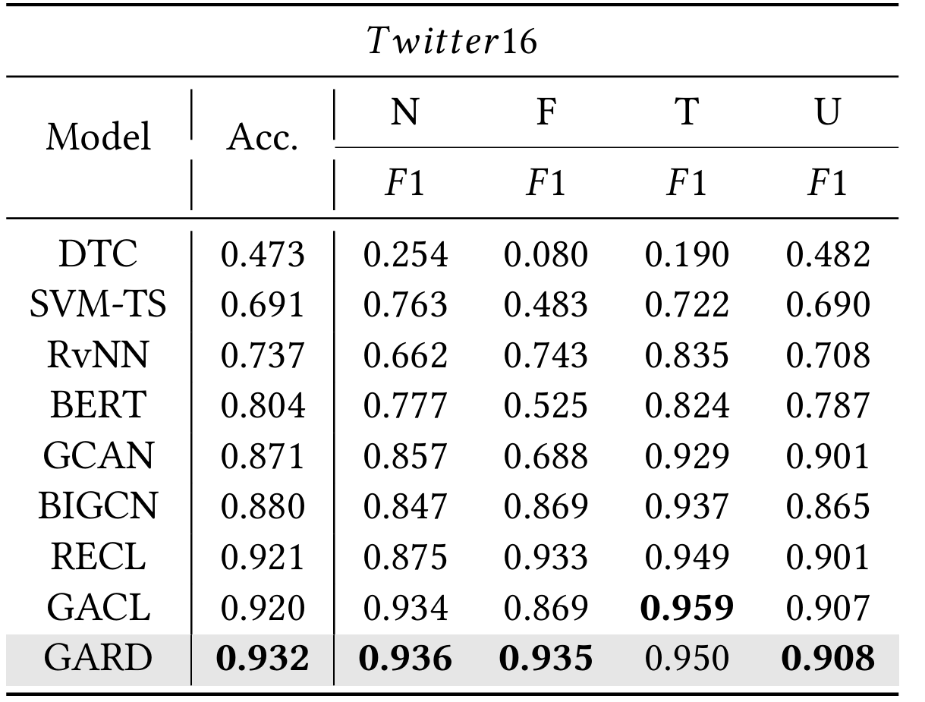
ATAI
Advanced Technique of Artificial Intelligence
ATAI
ChongqingUniversity _{AdvancedTechniqueof}
of Technology Artificial Intelligence
Chongqing University of
Technology
Chongqing University ^{ATAI}
_{of Technology} Advanced Techniqueof
Artificial Intelligence
Chongqing University of Technology
Chongqing University of Technology
Experiments

Slide 11
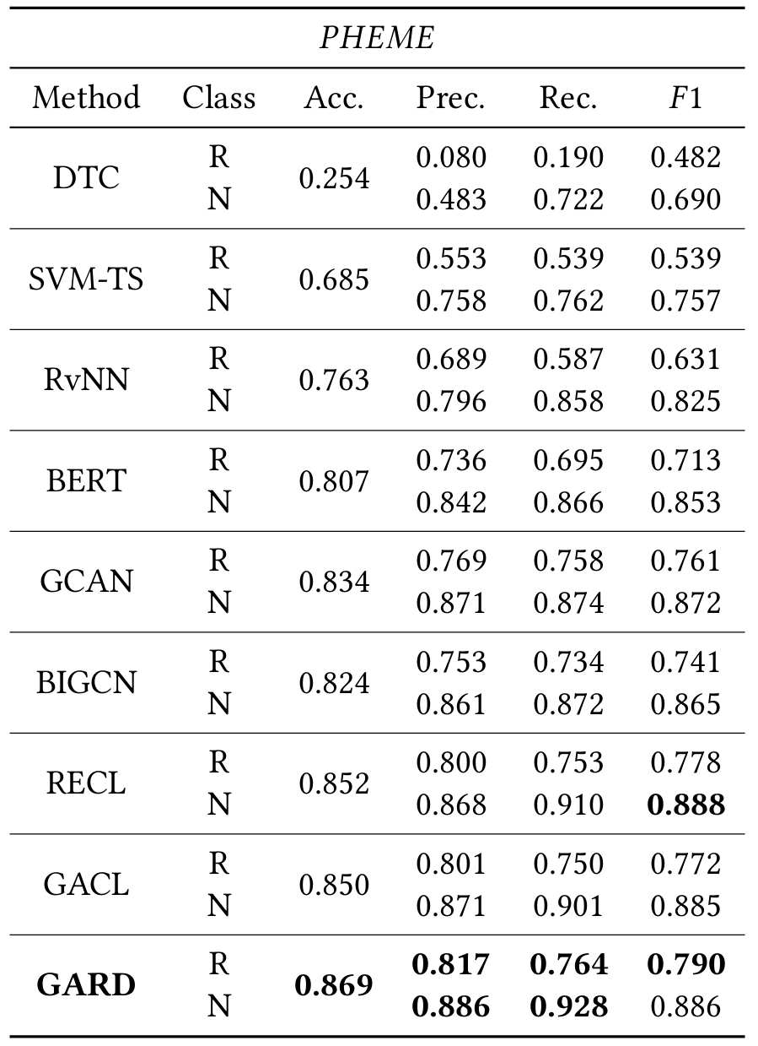
ATAI
Advanced Technique of Artificial Intelligence
ATAI
ChongqingUniversity _{AdvancedTechniqueof}
of Technology Artificial Intelligence
Chongqing University of
Technology
Chongqing University ^{ATAI}
_{of Technology} Advanced Techniqueof
Artificial Intelligence
Chongqing University of Technology
Chongqing University of Technology
Experiments

Slide 12
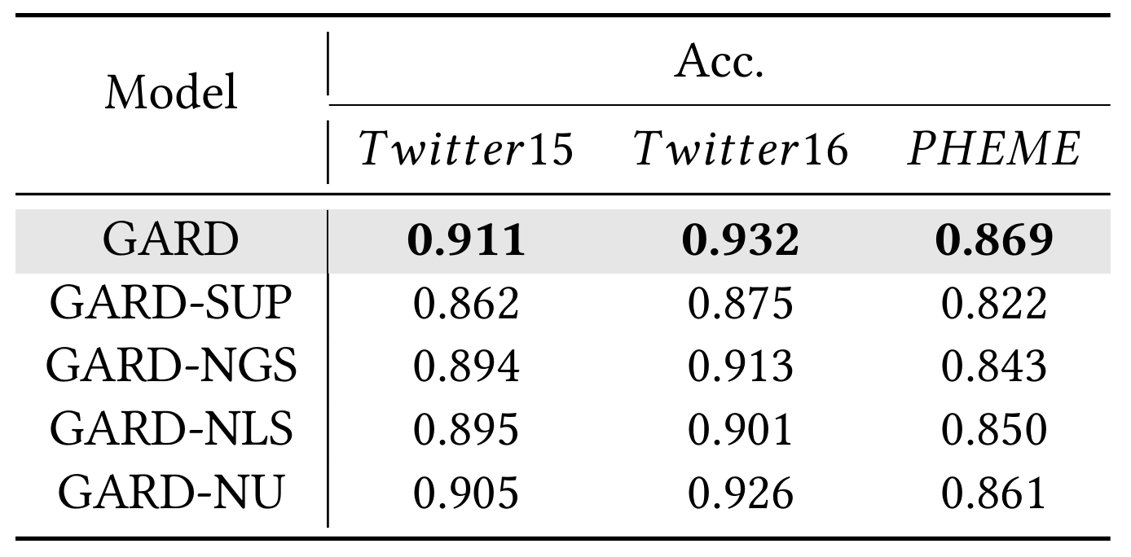
ATAI
Advanced Technique of Artificial Intelligence
ATAI
ChongqingUniversity _{AdvancedTechniqueof}
of Technology Artificial Intelligence
Chongqing University of
Technology
Chongqing University ^{ATAI}
_{of Technology} Advanced Techniqueof
Artificial Intelligence
Chongqing University of Technology
Chongqing University of Technology
Experiments

Slide 13
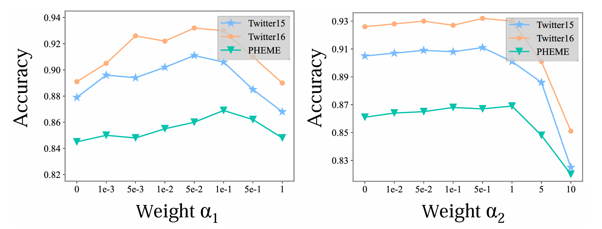
ATAI
Advanced Technique of Artificial Intelligence
ATAI
ChongqingUniversity _{AdvancedTechniqueof}
of Technology Artificial Intelligence
Chongqing University of
Technology
Chongqing University ^{ATAI}
_{of Technology} Advanced Techniqueof
Artificial Intelligence
Chongqing University of Technology
Chongqing University of Technology
Experiments

Slide 14
ATAI
Advanced Technique of Artificial Intelligence
ATAI
ChongqingUniversity _{AdvancedTechniqueof}
of Technology Artificial Intelligence
Chongqing University of
Technology
Chongqing University ^{ATAI}
_{of Technology} Advanced Techniqueof
Artificial Intelligence
Chongqing University of Technology
Chongqing University of Technology
Experiments

Slide 15
ATAI
Advanced Technique of Artificial Intelligence
ATAI
ChongqingUniversity _{AdvancedTechniqueof}
of Technology Artificial Intelligence
Chongqing University of
Technology
Chongqing University ^{ATAI}
_{of Technology} Advanced Techniqueof
Artificial Intelligence
Chongqing University of Technology
Chongqing University of Technology
Thanks!

